Slide 1
How Data and Design Changed Client Behavior
Insights from a Digital Experiment

Slide 2
The Challenge
Current State
Clients abandon processes before completion, causing inefficiencies.
Opportunity
Could a modern UI with in-context prompts improve the experience and outcomes?
Hypothesis
A redesigned process will increase completion rates and reduce drop-offs.

Slide 3
How We Cleaned the Data
Design
A/B Test comparing Control (current process) and Test (redesigned UI).
Steps
Step 0: Start → Step 1 → Step 2 → Step 3 → Step 4 (Completion).
Measurement Period
March 15 – April 30, 2017.
Goal
Measure and compare completion rates, process efficiency, and client behavior.

Slide 4
How We Cleaned the Data
Objective
Ensure reliable, relevant, and consistent data for analysis.
Steps taken before joining the three datasets
Removed duplicates and rows with null values from all three datasets.
Filtered the web data within the measurement period (2017/03/15 – 2017/04/30).
Mapped categorical process steps ('start', 'step_1', etc.) to numerical values (0–4).
Converted the 'date_time' column to datetime format for easier manipulation.
Standardized the 'gendr' column by replacing small count values (e.g., 'X') with 'U'

Slide 5
How We Cleaned the Data
Steps taken after joining the three datasets
Concatenated client_id, vistor_id and visit_id to create a primary key
Removed client_visit_keys without process_step 0
Retained the earliest step 0 and the latest record for each other step

Slide 6
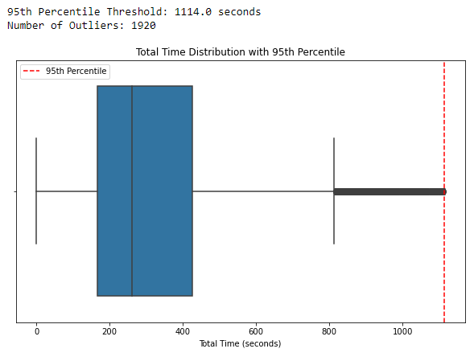
How We Cleaned the Data
Steps taken after joining the three datasets
Filter out 5% outliers using Total Time

Slide 8
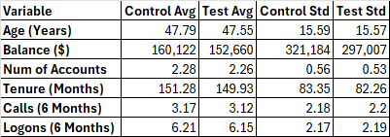

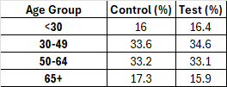
WHO ARE WE HELPING

Slide 9
Two content layout with table
First bullet point here
Second bullet point here
Third bullet point here
Class | Group 1 | Group 2
Class 1 | 82 | 95
Class 2 | 76 | 88
Class 3 | 84 | Class 2 | 76 | 88
 |  | Class 3 | 84 | Class 2 | 76 | 88
 |  |  |  | Class 3 | 84 | 90

Slide 10
What Success Looks Like
Primary Metric
Completion Rate = (Clients Done Step 4) / (Clients Starting at Step 0)
Secondary Metrics
Drop-Off Rates at Each Step.
Time to Complete: Faster times indicate improved usability.

Slide 11
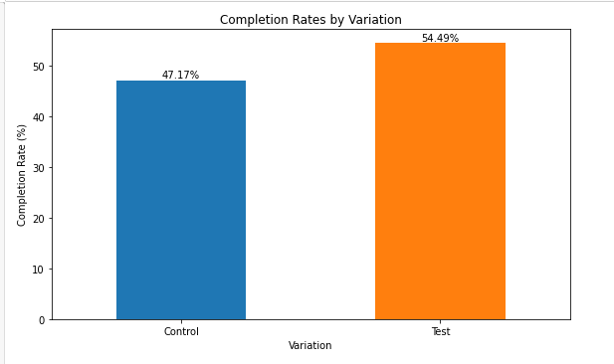
COMPLETION RATES

Slide 12
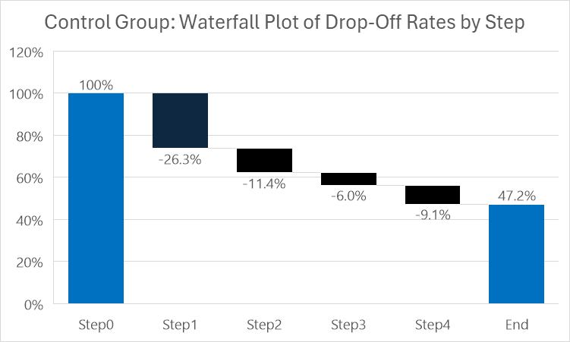
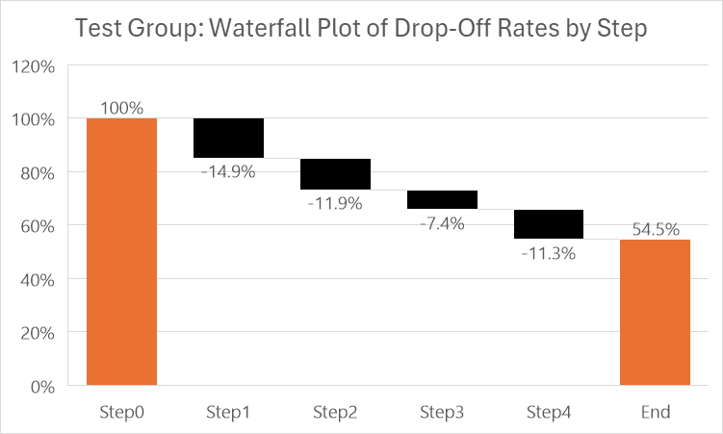
DROP-OFF RATES AT EACH STEP

Slide 13
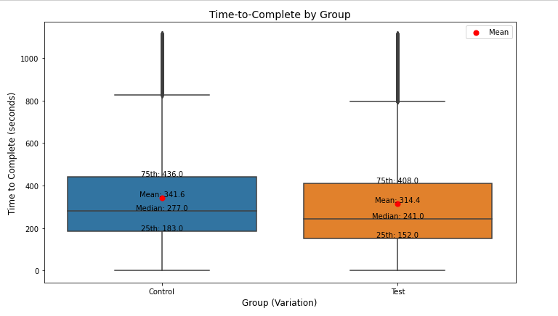
TIME-TO-COMPLETE BY GROUP

Slide 14
LOGISTIC REGRESSION COMPARISON (CONTROL VS TEST)
Variable | Control Estimate | Control P-Value | Test Estimate | Test P-Value | Notes
Intercept | 0.4618 | 0.0252 | 0.841 | <0.0001 | Baseline likelihood is higher in Test group.
Gender (F) | -0.1032 | 0.0025 | -0.123 | <0.0001 | Stronger negative impact in Test group.
Gender (U) | -0.0582 | 0.1325 | -0.083 | 0.024 | Not significant in Control group but marginal in Test group.
Age 30-49 | -0.0604 | 0.1476 | -0.22 | <0.0001 | Age 30-49 is significant only in Test group.
Age 50-64 | -0.256 | <0.0001 | -0.4935 | <0.0001 | Age 50-64 has strong negative impact in both groups.
Age 65+ | -0.7416 | <0.0001 | -0.9337 | <0.0001 | Age 65+ has the strongest negative impact in both groups.
Number of Accounts | 0.0508 | 0.0518 | 0.1465 | <0.0001 | Significant in Test group but marginal in Control group.
Calls (6 Months) | 0.0175 | 0.7836 | 0.1249 | 0.0332 | Marginal significance in Test group but not in Control group.
Logons (6 Months) | -0.0767 | 0.226 | -0.1497 | 0.0109 | Logons are significant in Test group but not in Control group.
Balance | 4.50E-08 | 0.6589 | 2.97E-08 | 0.5235 | Not significant in either group.
Client Tenure (Months) | 0 | 0.6191 | 0.0002 | 0.7411 | Not significant in either group.

Slide 15
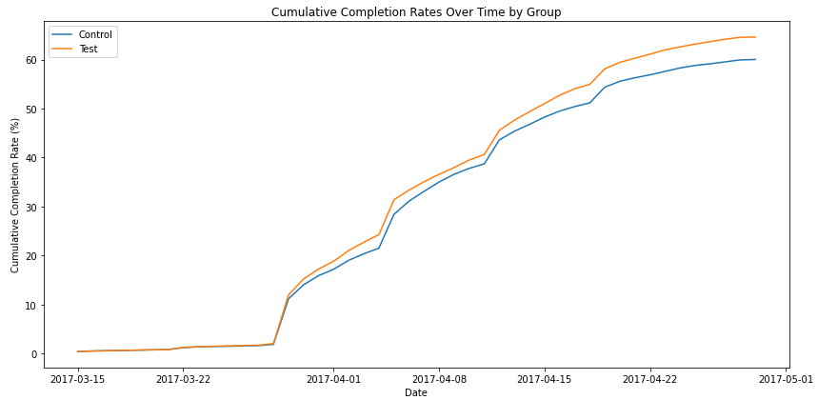
CUMULATIVE COMPLETION RATES OVER TIME BY GROUP

Slide 16
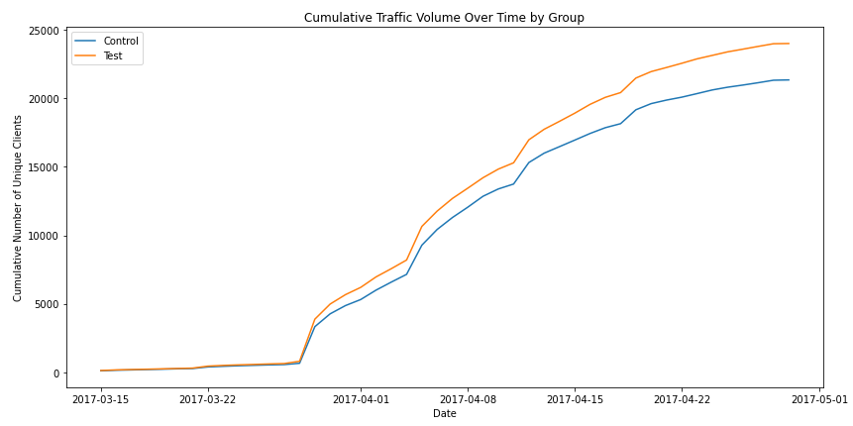
CUMULATIVE NUMBER OF UNIQUE CLIENTS

Slide 17
Title and content layout with chart

Slide 18
Title and content layout with SmartArt
Step 1 Title
Task description
Step 2 Title
Task description
Step 3 Title
Task description

Slide 19
Add a Slide Title - 2

Slide 20
Add a Slide Title - 3

Slide 22
Add a Slide Title - 4

Slide 23
Add a Slide Title - 5

